Slide 1
Product Perspective Discovery and Evaluation by Analysing tweets
Instructor: Prof. Rong Liu
Course: BIA 660 D
Presented By:
Gaurav Sawant
Geetkaur Sukhmani
Omkar Desai
Sayan Mukherjee

Slide 2
Introduction
Social Media has become a destination for posting opinions, reviews and questions about products.
The posts come from a variety of people - experts, reviewers, brand/marketing managers, customers (prospective and current).
Following a particular channel or reviewer could lead to receiving biased or uni-dimensional information.
If we look at multiple channels or reviewers together, the information can be overwhelming making it difficult to filter out the noise.

Slide 3
What Problem is being Solved?
Our motivation and target.
Given this goldmine of information that is Social Media, can we utilise it to gauge the perception of a particular product amongst the masses?
This discovery and evaluation of this perception, will help organizations understand consumer behavior and patterns.
Primary aim is to identify some common themes that people are posting about and what ties these themes together.
Is the general sentiment of the posts leaning towards positive, negative or neutral in nature.
Additionally, what is the sentiment in isolation to the themes we have identified.

Slide 4
Web Scraping
And
Exploratory Data Analysis

Slide 5
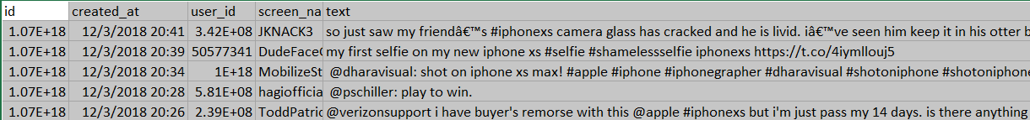
Web Scraping
Twitter API
Use tweepy to get results for three Apple products using keywords
iPhone X
iPhone XR
iPhone XS
Each data set has over 10K tweets

Slide 6
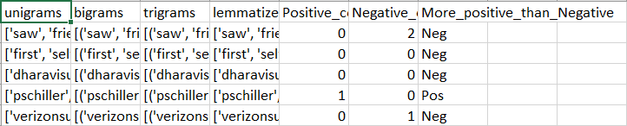
Data Pre-Processing
Keep duplicates since that will give us a better idea of
perception
sentiment
common topics being discussed - themes
Use NLTK for stopwords, POS tags and Wordnet Lemmatizer to generate
Tokens (Unigram) and lemmatized tokens
Bigrams
Trigrams
Positive, Negative keyword count

Slide 7
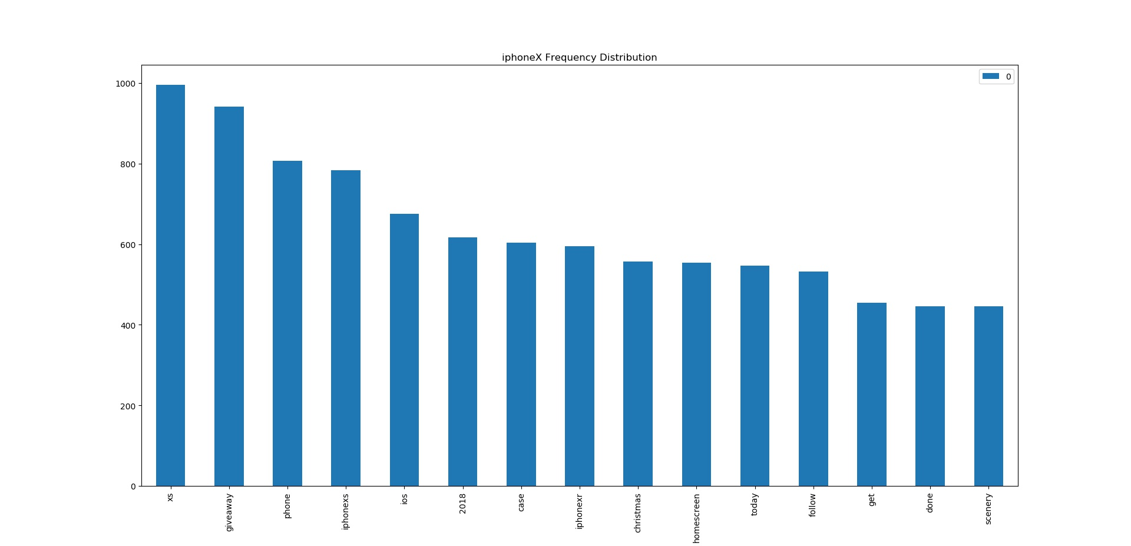
Exploratory Data Analysis
Token frequency distribution for iPhone X
Additional stopwords: "http","vs", "free", "download","enter", "chance", "win","via", "youtube", "comparison"
Notes:
Stop Words: ["1", "2", "3", "x", "http", "https", "iphone", "apple", "iphonex", "X", "x", "vs", "iphonexsmax", "wallpapers", "free", "download", "one", "'iphon…",
"enter", "chance", "win", "64", "gb", "via", "youtube", "comparison", "new", "play", "max", "wallpaper", "ar72014", "’"]

Slide 8
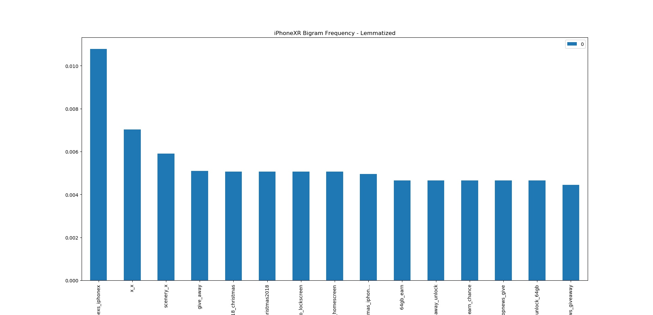
Bigram Frequency - Lemmatized
Bigrams generated from iPhone XR data set
Notes:
Notice bigrams like x_x which don’t make sense

Slide 9
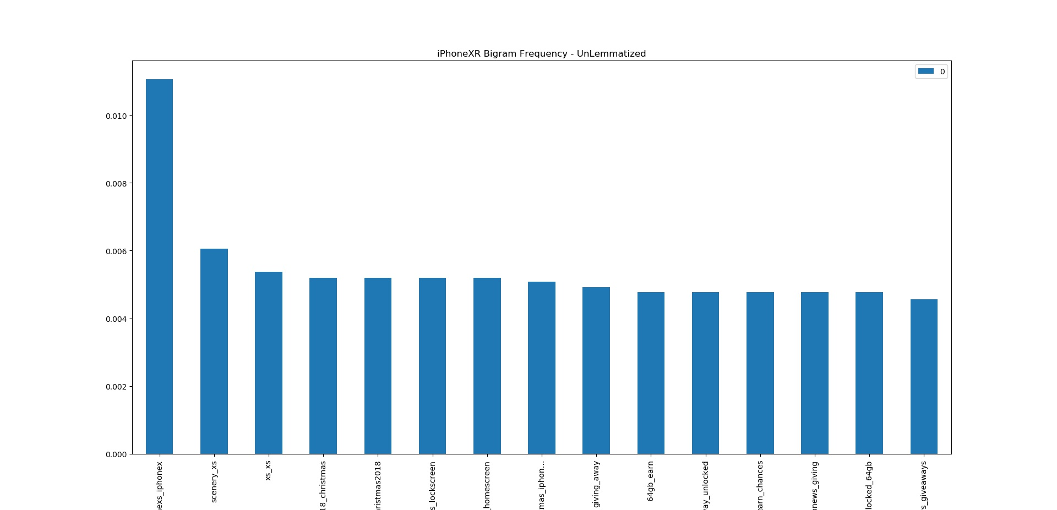
Bigram Frequency Un-Lemmatized
This depicts the influence of lemmatization and stemming on the data set.
Notes:
The bigrams were actually xs_xs

Slide 10
Topic Modelling
and
Labelling the tweets

Slide 11
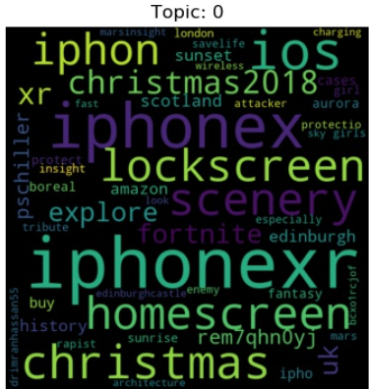
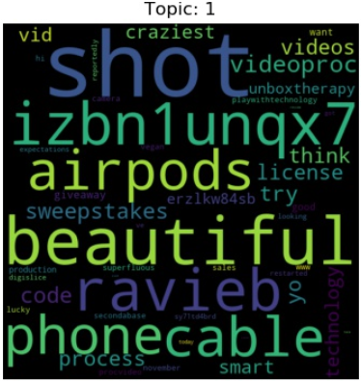
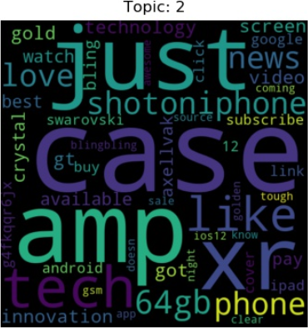
Topic Modelling
Use sklearn LDA for Topic Modelling - iPhone XS
Topic 0: Demand of Comparable/Competing Products (iPhone X, iPhone XR)
Topic 1: Features (beautiful, cable, airpods)
Topic 2: Accessories (case, amp, watch)

Slide 12
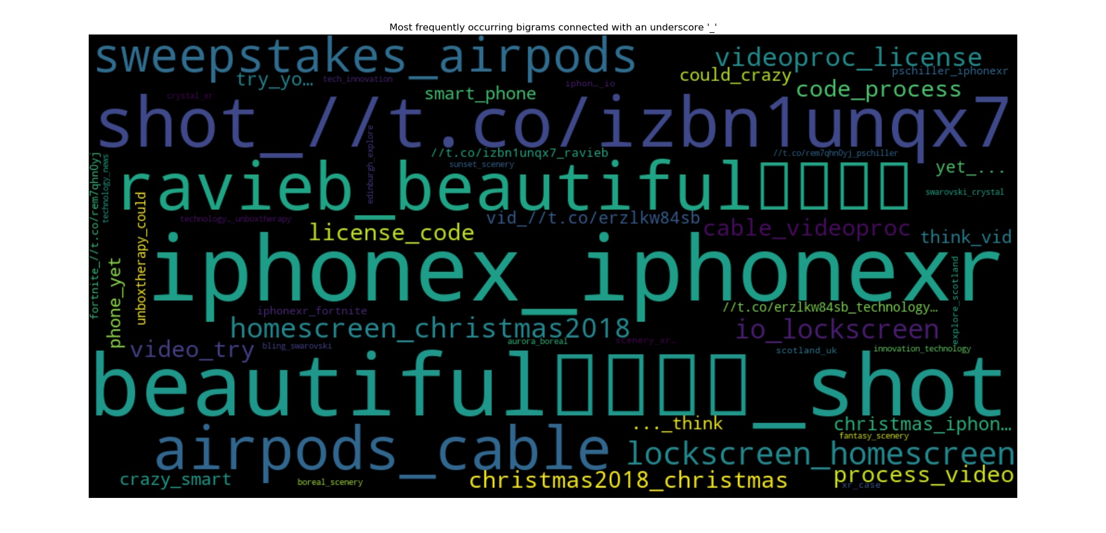
Bigram Collocations on Topic Model
Lemmatization is turned On. Bigrams are connected using underscore.

Slide 13
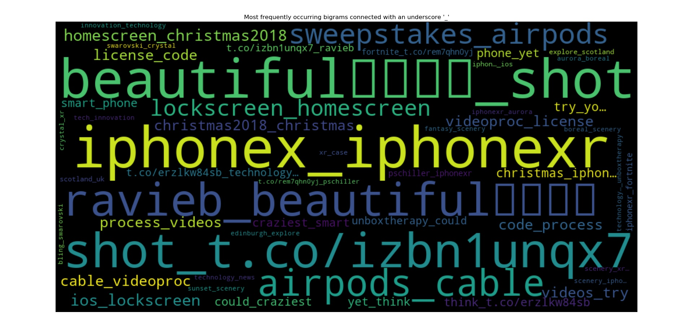
Lemmatization is Off.
Notice same pairs like iphonex_iphonexr, beatiful_shot, airpods_cable

Slide 14
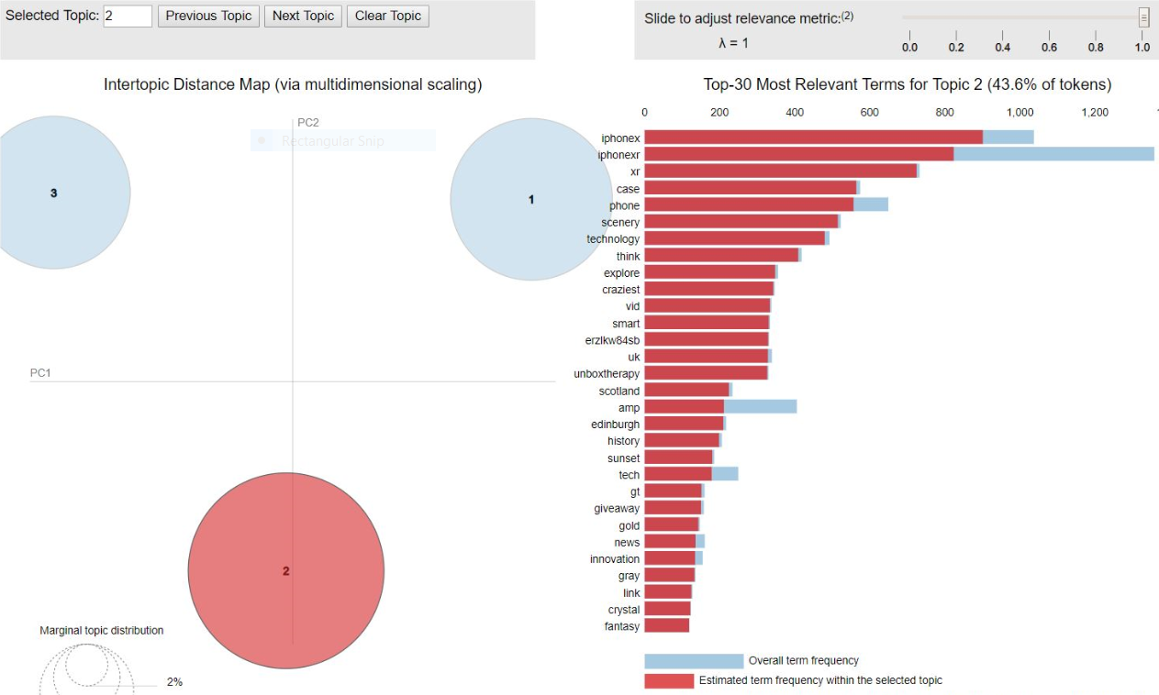
Re-evaluation Topic Modelling
Use the gensim LDA to draw comparison

Slide 15
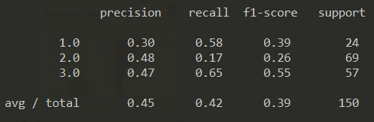
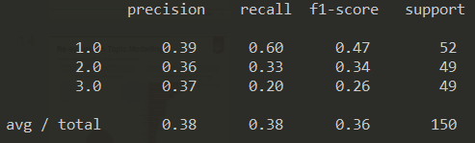
Model Performance and tuning
Manually label data set for Classification Report.
Classification Report for iPhone XS data set Classification Report for iPhone XR data set
For performance tuning
Count Vectorizer max_df in the range [0.80, 0.90]
Count Vectorizer min_df in the range [10, 50]
Gensim LDA: lambda 0.2, 0.4, 0.6, 0.8, 1.0
Gensim symmetric vs asymmetric vs auto
Smaller alpha results in more sparse distribution of words in topics
Notes:
Address accuracy and self-labeled data set

Slide 16
CLUSTERING
Using K-Means (Scikit Learn)
Used Clustering as we were aware that our data is unlabelled.
Tried multiple n for num_clusters.
Also labelled a small set of data manually to find out the time distribution of the nature of comments.
Found out the Precision and recall for the dataset
Found out some interesting results from there

Slide 17
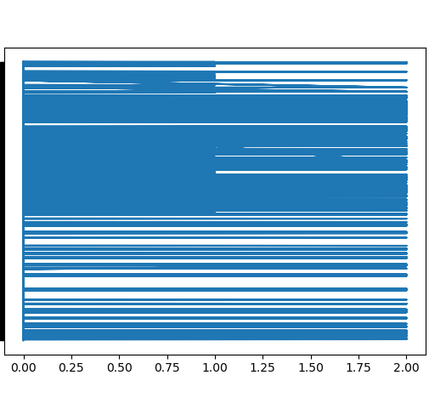
Cluster concentration vs time of comment
iPhone XR
Legend:
Label 1: Competitors/Buying/Accessories
Label 2: Features
Labels 3: News
Notes:
Initially before people get the phones, most of the tweets are about Buying and News. Through the bulk of the post release phase, People predominantly talk about the features of the phone and then the concentration goes back to buying, news and accessories.

Slide 18
Hierarchical Clustering
Agglomerative clustering - bottom up approach is used ,starting from the data points and clustering the way up.
Principle - Similar data points are grouped together, similar groups are further grouped together depending on their distances from each other .
For XR
Label 1: Competitors/Buying/Accessories
Label 2: Features
Labels 3: News
For XS
1: Accessories
2: Competitor
3: Camera

Slide 19
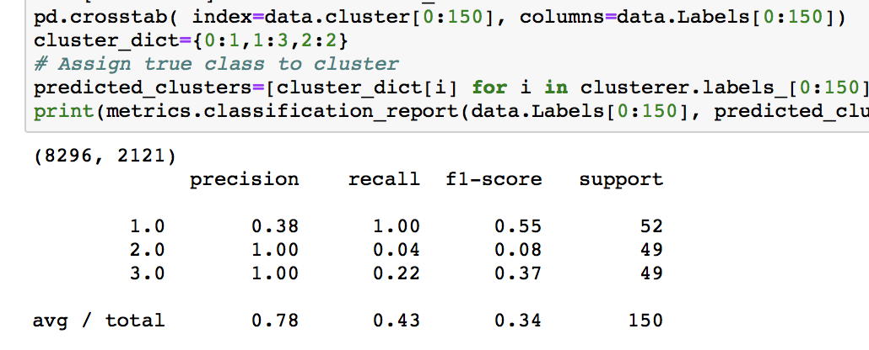
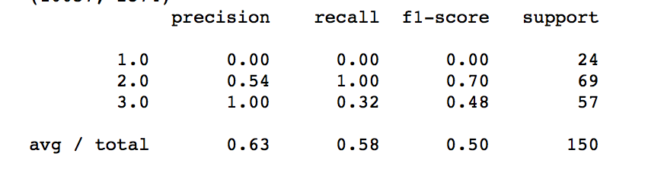
Hierarchical clustering metrics report for iphone XS and iphone XR
Using ward as Linkage and euclidean distance.
iphone XR
iphone XS
precision - Checks for accuracy of the model
recall - true positive rate
f1 score - combines precision and recall

Slide 20
Hierarchical Vs Kmeans Clustering
Hierarchical clustering has more flexibility and fewer assumptions regarding the underlying data(For eg, predefining k).
Hierarchical clustering computationally more expensive , but provides more intuitive results.
Kmeans provides faster results than hierarchical clustering.

Slide 21
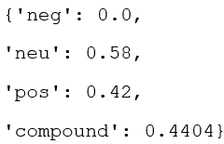
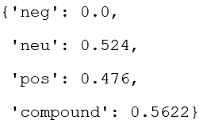
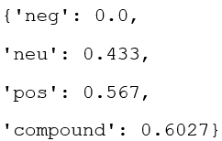
Sentiment Analysis using VADER
In addition to Topic Modeling and Clustering for understanding people’s views about the new product we also performed Sentiment Analysis using VADER
Reasons to choose VADER:
VADER works very well with social media text
It handles things like exclamation marks, capitalization, emojis, slangs and acronym text

Slide 22
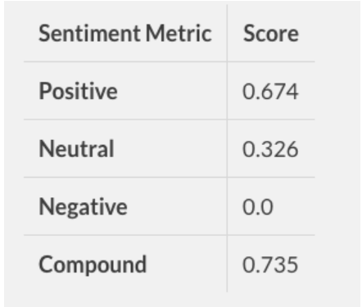
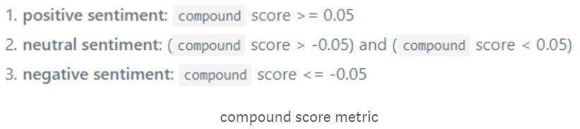
Sentiment Analysis VADER
Understanding VADER
The positive, negative & neutral scores represent proportion of text falling into these categories
The compound score is a metric that calculates the sum of all the lexicon ratings which have been between -1 (most extreme negative) and +1 (most extreme positive)

Slide 23
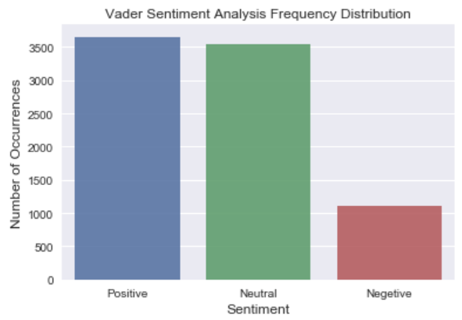
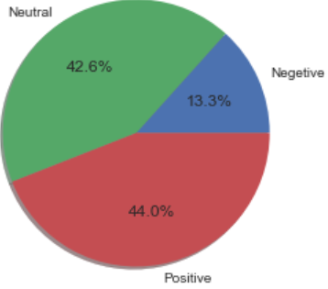
Sentiment Analysis VADER results
Results for iPhoneXR
Sentiment Pie Chart - iPhoneXR
Frequency Distribution Bar Chart - iPhoneXR

Slide 24
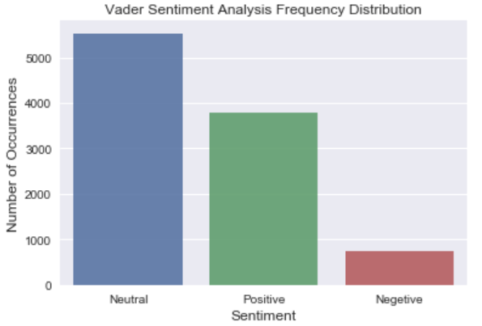
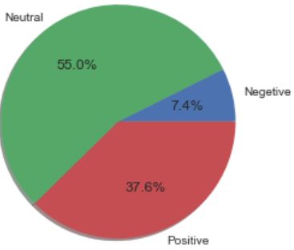
Sentiment Analysis VADER results
Results for iPhoneXS (Considerably more Neutral Sentiment than iPhone XR)
Sentiment Pie Chart - iPhoneXS
Frequency Distribution Bar Chart - iPhoneXS

Slide 25
Existing Work vs Our Work
Existing Work | Our Work
In 2011, Booth and Matic in their paper, Mapping and Leveraging Influencers in Social Media to shape Corporate Brand Perceptions tried to identify and focus on social media influencers and understand their impact over target audiences | We did not focus on a specific group rather we studied the views of all people. Results may have been different if we had restricted our study to a particular
Katja Hutter discusses in her paper, The impact of user interactions in social media on brand awareness and purchase intention discusses how brand user interaction activities can affect the perception of a brand | We have chosen a brand, i.e. apple but we do not necessarily focus on brand to user interaction
Norman Booth, Julie Ann Matic, (2011) "Mapping and leveraging influencers in social media to shape corporate brand perceptions", Corporate Communications: An International Journal, Vol. 16 Issue: 3, pp.184-191,
Katja Hutter, Julia Hautz, Severin Dennhardt, Johann Füller, (2013) "The impact of user interactions in social media on brand awareness and purchase intention: the case of MINI on Facebook", Journal of Product & Brand Management, Vol. 22 Issue: 5/6, pp.342-351, https://doi.org/10.1108/JPBM-05-2013-0299

Slide 26
Challenges and Future Work
Challenges:
Need of labeling by an expert to increase the validity of the project
Labeling done by us can introduce some bias. There is unsurety about the appropriateness of the label.
Labeling large number of rows can give better results but is time consuming
Future Work:
Conduct sentiment analysis on clusters that we get
Work on the tweets of social media influencers and retweets that these tweets get

Slide 27
References
Simplifying Sentiment Analysis using VADER in Python (on Social Media Text), Parul Pandey, Medium, Sept 23 2018
Using VADER to handle sentiment analysis with social media text, April 08 2017, Jodie Burchell
Norman Booth, Julie Ann Matic, (2011) "Mapping and leveraging influencers in social media to shape corporate brand perceptions", Corporate Communications: An International Journal, Vol. 16 Issue: 3, pp.184-191,
Katja Hutter, Julia Hautz, Severin Dennhardt, Johann Füller, (2013) "The impact of user interactions in social media on brand awareness and purchase intention: the case of MINI on Facebook", Journal of Product & Brand Management, Vol. 22 Issue: 5/6, pp.342-351

